Slide 1
Day 2

Slide 2
Data Source File
https://drive.google.com/drive/folders/1xcmHEYOB0clh54Y4-3EqEd0Fz8X8KYDk

Slide 3
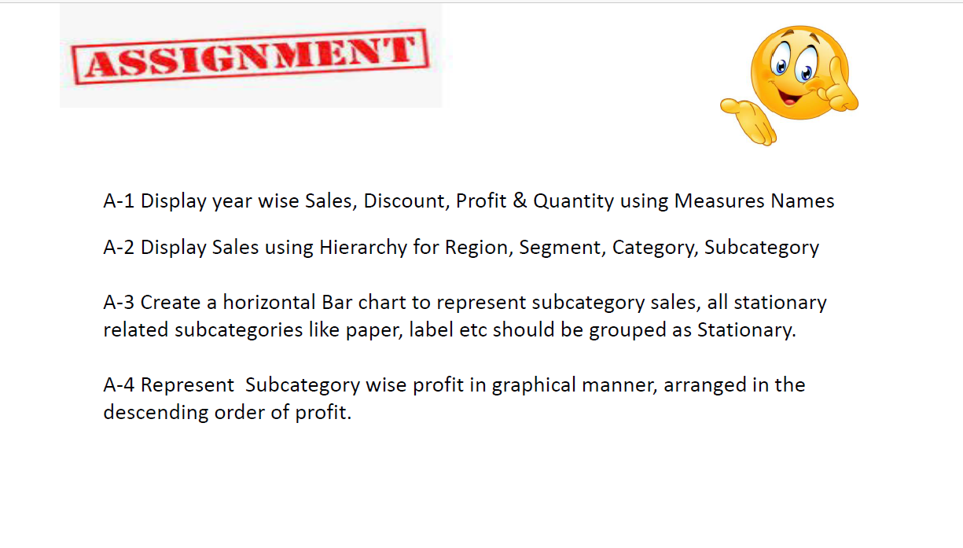
Questions:

Slide 4
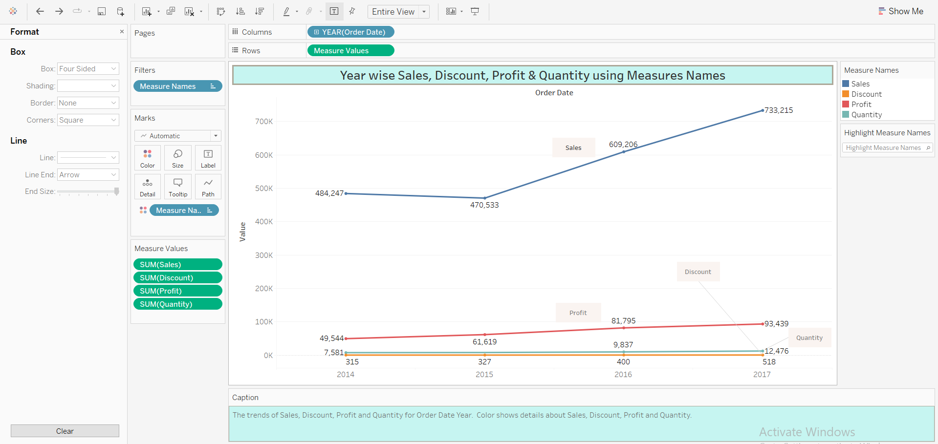
Display year wise Sales, Discount, Profit & Quantity using Measures Names

Slide 5
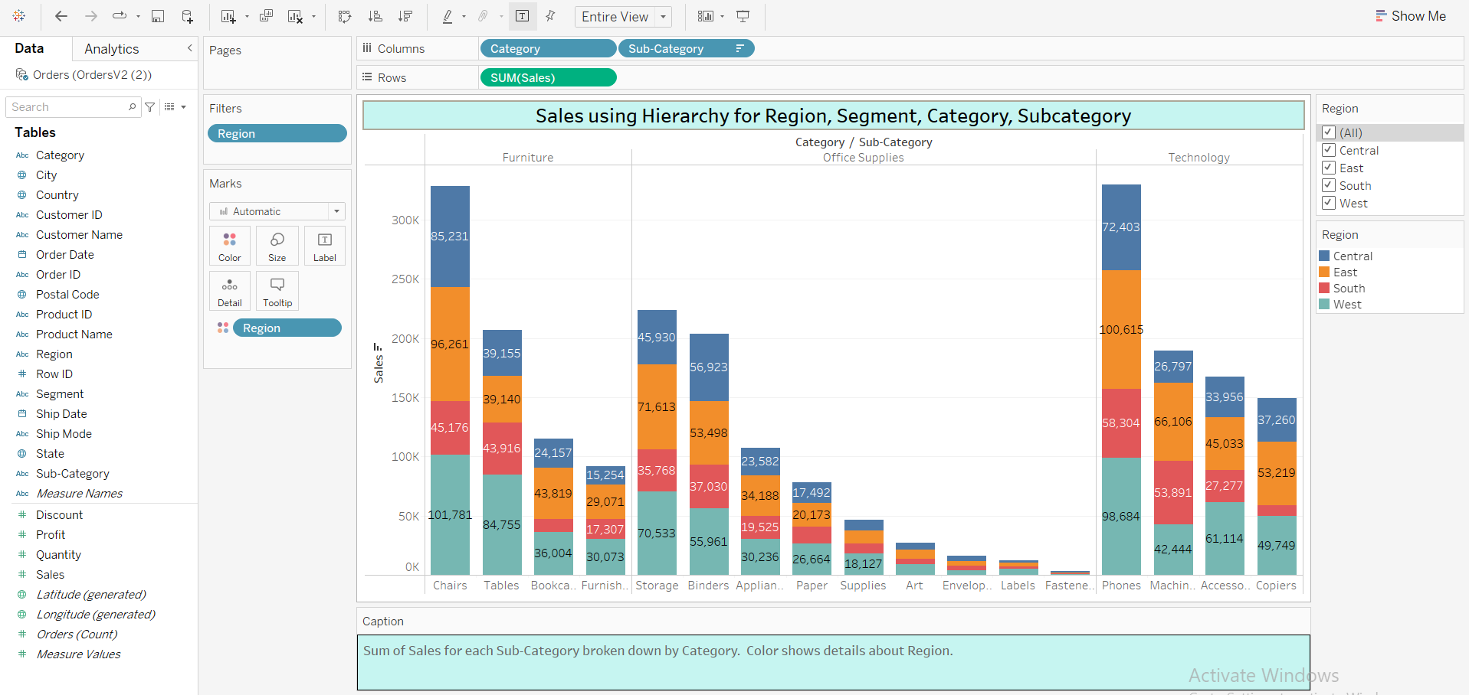
Sales using Hierarchy for Region, Segment, Category, Subcategory

Slide 6
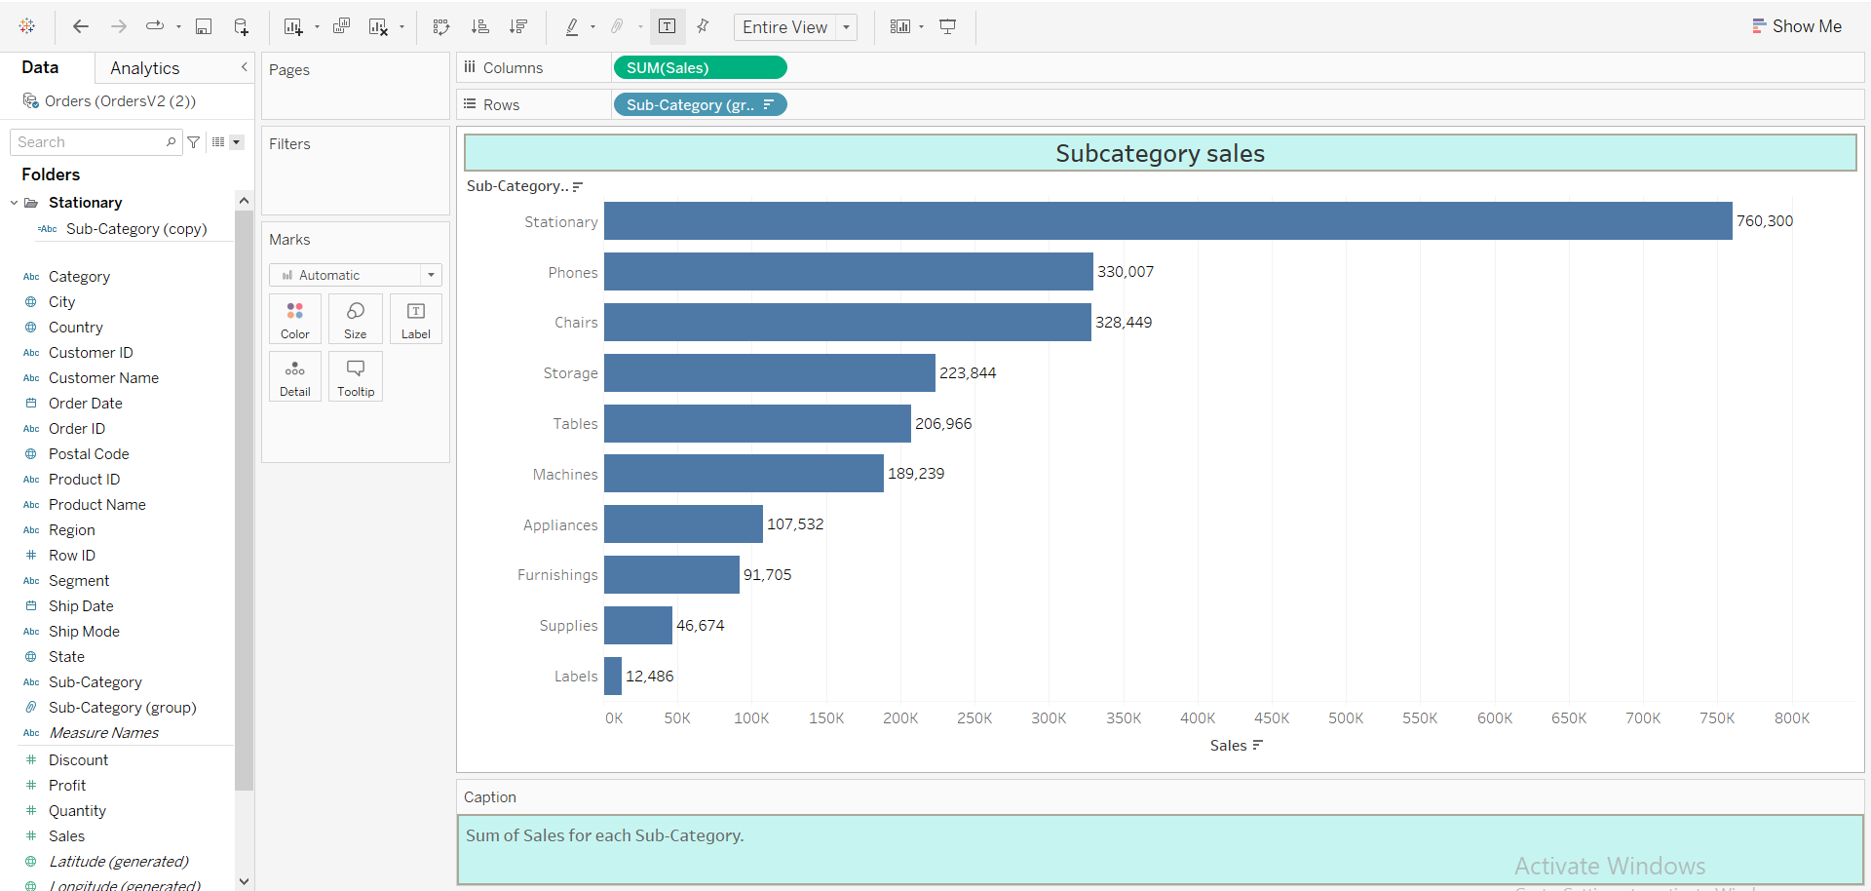
A horizontal Bar chart to represent subcategory sales, all stationary related subcategories like paper, label etc should be grouped as Stationary.

Slide 7
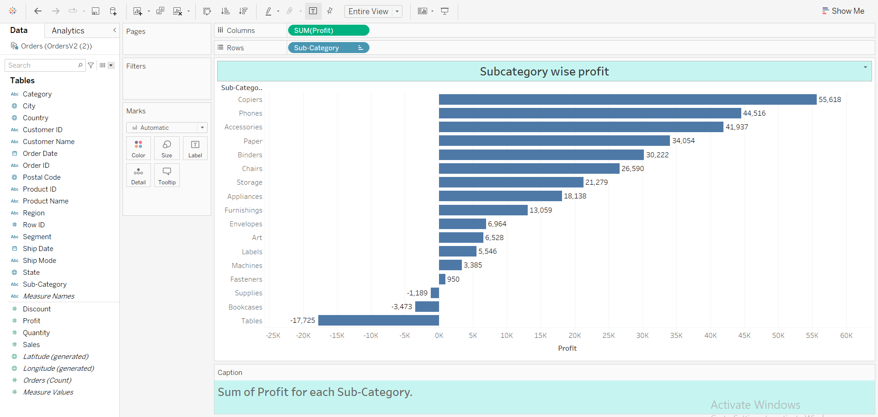
Subcategory wise profit in graphical manner, arranged in the descending order of profit.

Slide 8
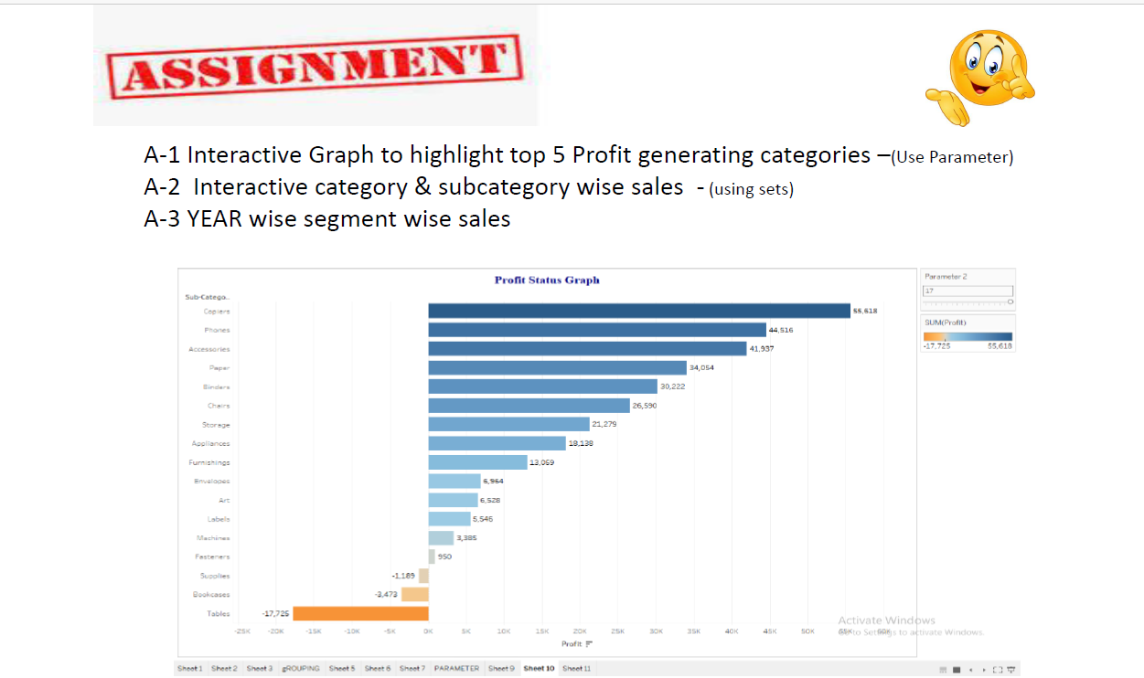
Questions:

Slide 9
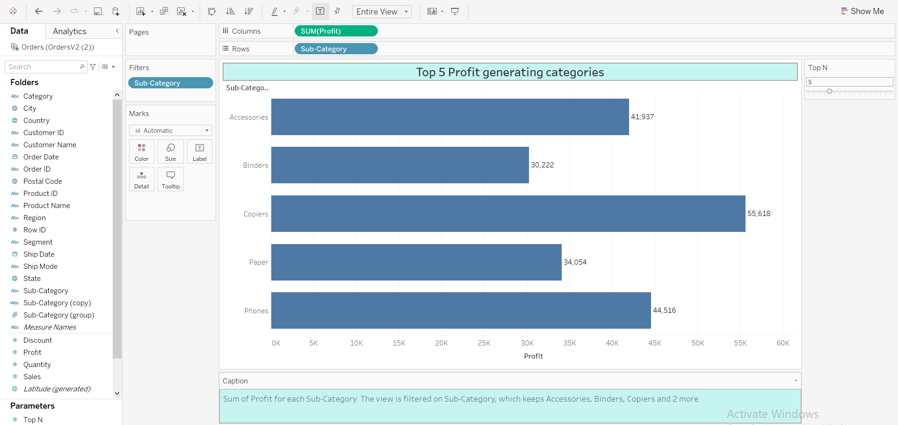
Interactive Graph to highlight top 5 Profit generating categories

Slide 10
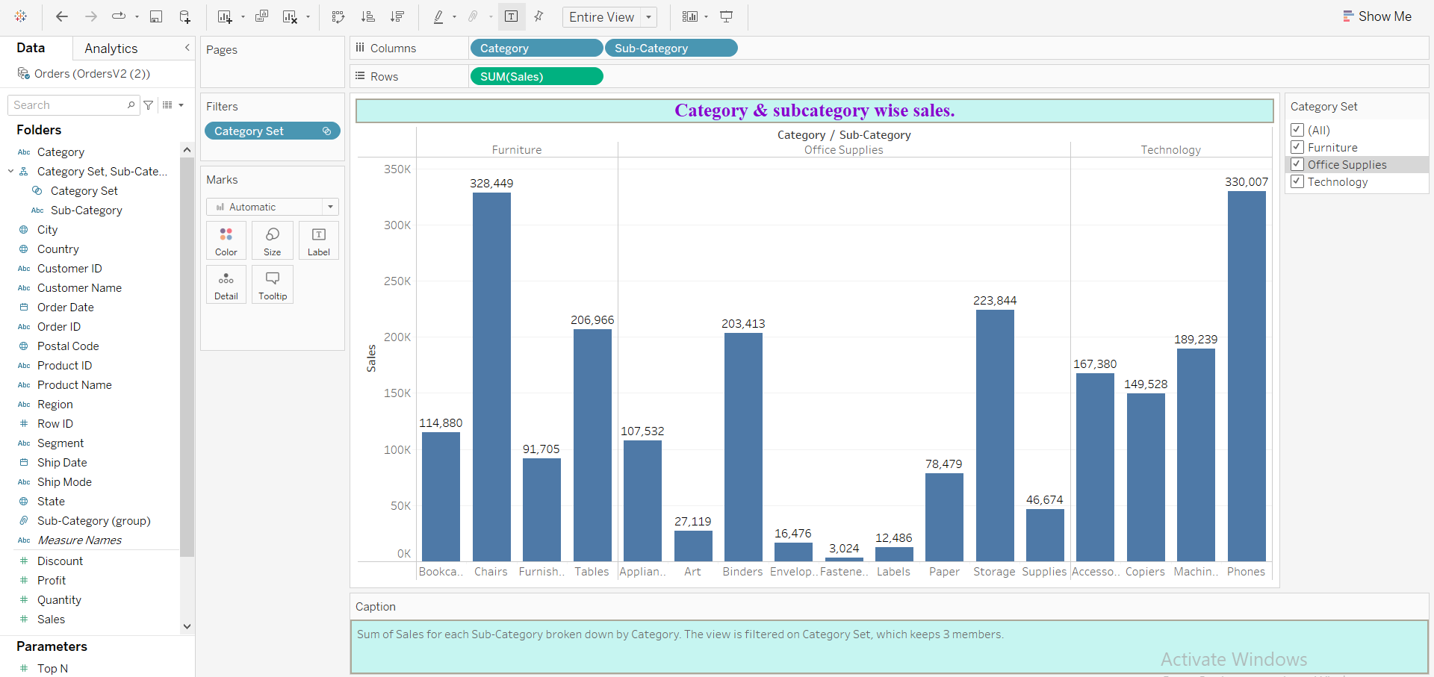
Interactive category & subcategory wise sales

Slide 11
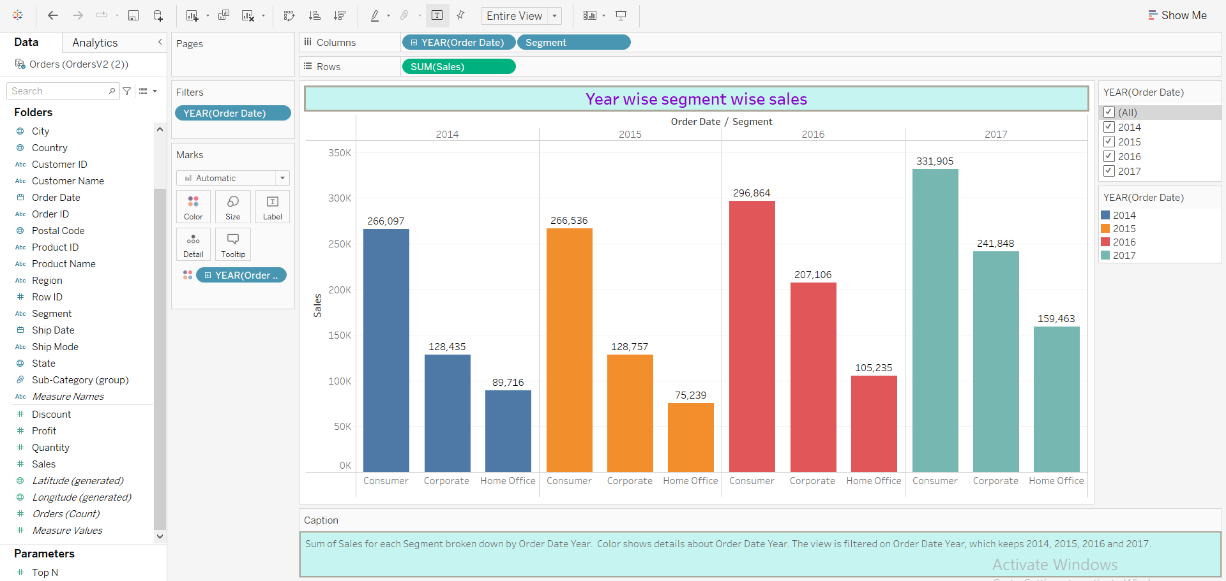
Year wise segment wise sales

Slide 12
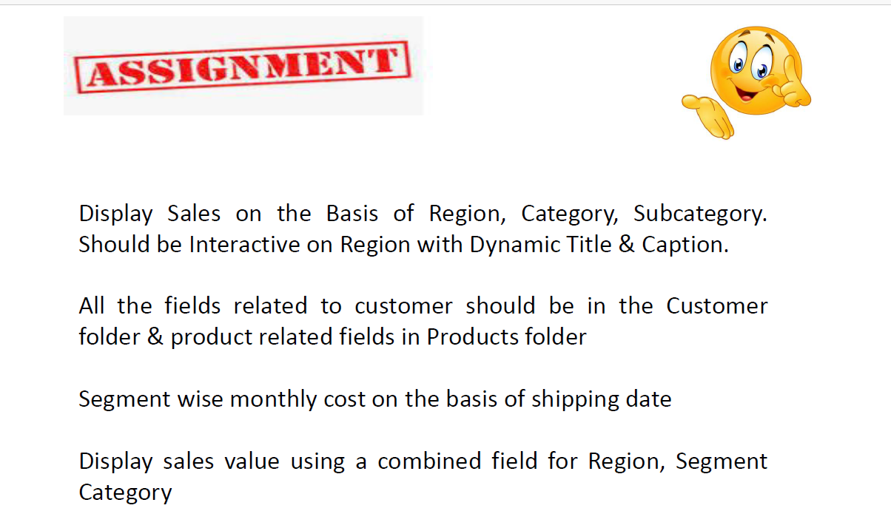
Questions:

Slide 13
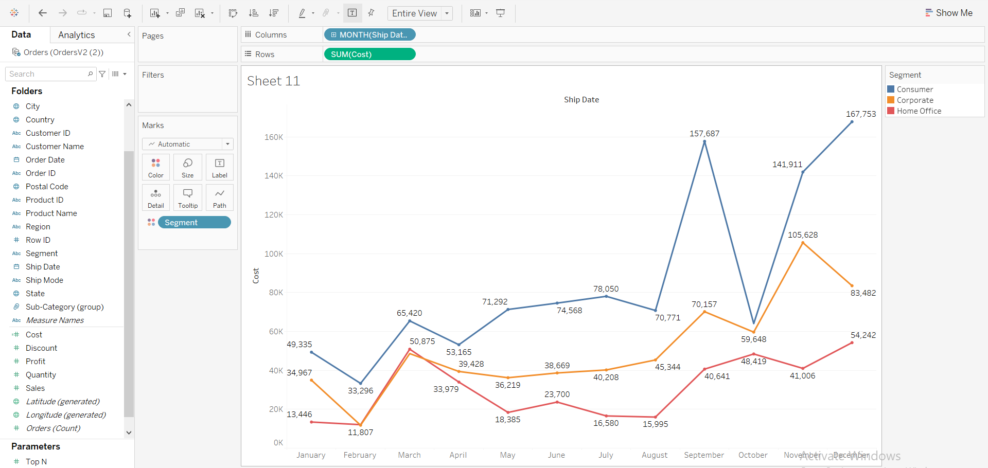
Segment wise monthly cost on the basis of shipping date.

